Slide 1
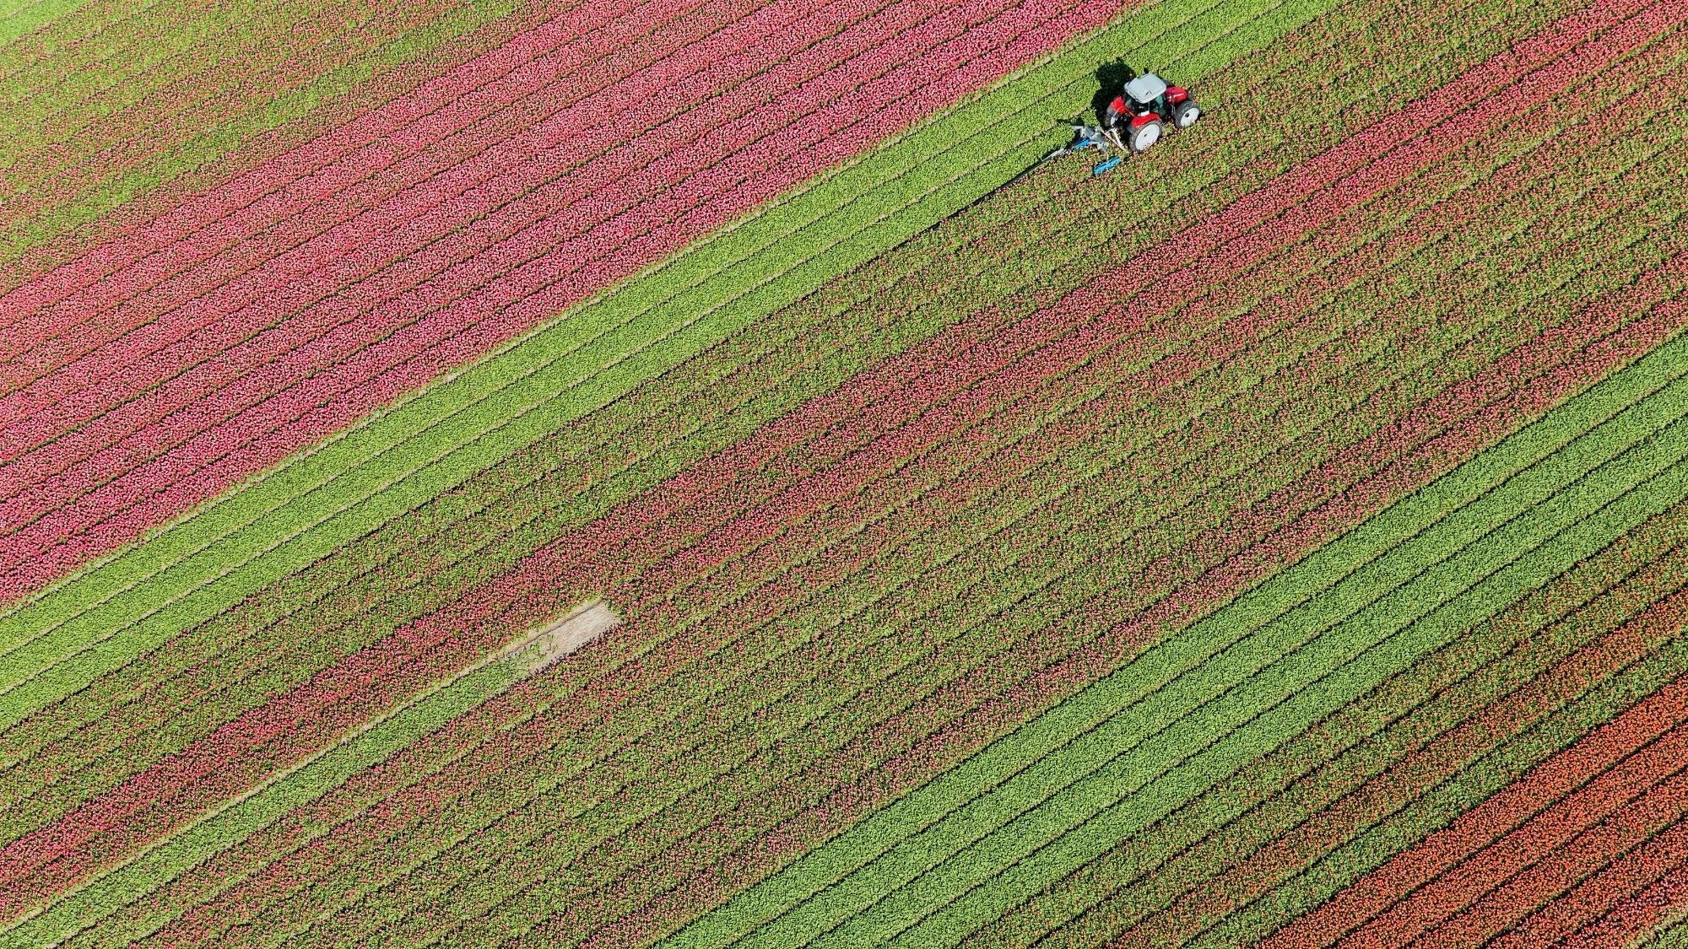
Sprint-4

Slide 2
Agenda
ASSIGNMENT-1
ASSIGNMENT-2
ASSIGNMENT-3
ASSIGNMENT-4

Slide 3
ASSIGNMENT-1
Given two 2D or 3D points find out equation of line which passes through these points. And find out perpendicular distance of 3rd point from the line.

Slide 4
ASSIGNMENT-2
Change the above-mentioned program to accept a CSV file which has 3-point coordinates (first- and second-point coordinates useful for line and 3rd point for perpendicular distance) and write the perpendicular distance of the 3rd point from line in the same CSV as a new column.

Slide 5
ASSIGNMENT-3
Write a program to generate Cube, Cone, Rectangle, Cylinder and Sphere by taking user input and save it to STL file format. Write unit test cases for your program.

Slide 6
ASSIGNMENT-4
Generate 500 words simple English story text from ChatGPT and save it as txt file on your machine. Then write a console C++ application and read this text file using STL concept and print all the unique words in the file along with their occurrence count in CSV file

Slide 7
Thank You
Shubham Agrahari
Software Engineer Intern
Shubham.agrahari@cyncly.com

